Slide 1

CSE7101- Capstone Project
Review-1
Developement of AI-ML Based Models for Predicting agri-horticultural Commodities
Roll Number | Student Name
20221CCS0114 | CHETAN M
20221CCS0118 | VAIBHAV BAGUDURE
20221CCS0141 | PREETHESH KUMAR
Under the Supervision of,
Ms.Raesa Razeen
Assistant Professor
School of Computer Science and Engineering
Presidency University
Name of the Program: B.TECH
Name of the HoD: Dr. Anandaraj S.P
Name of the Program Project Coordinator: Ms. Shivabasamma. Beli
Name of the School Project Coordinators: Dr. Sampath A K , Dr. Geetha A

Slide 2
Content
Problem Statement
Objectives
Background and Related work for title Selection
Analysis of Problem Statement
Innovation or Novel Contributions
Git-hub Link
Timeline of the Project
References

Slide 3
Problem Statement Number: PSCS_406
Organization:
Category (Hardware / Software / Both) : Software
Problem Statement:
The Department of Consumer Affairs monitors the daily prices of 22 essential food
commodities through 550 price reporting centres across the country. The
Department also maintains buffer stock of pulses, viz., gram, tur, urad, moon and
masur, and onion for strategic market interventions to stabilize the volatility in
prices. Decisions for market interventions such as release of stocks from the buffer
are taken on the basis of the price trends and outlook. At present, the analyses of
prices are based on the seasonality, historical and emerging trends, market
intelligence inputs, crop sowing and production estimates. ARIMA based economic
models have also been used to examine and forecast prices of pulses

Slide 4
Objectives:
To develop AI/ML-based models that predict short-term and long-term prices of essential commodities.
To integrate real-time and historical datasets for improved price forecasting accuracy.
To provide an easy-to-use decision support tool for government agencies and farmers.
To contribute toward SDG 12 – Responsible Consumption and Production by reducing price volatility and ensuring market stability.

Slide 5
Background and Related work for Title Selection
The Department of Consumer Affairs tracks 22 essential commodities via 550 centers.
Current models use ARIMA (time series forecasting), seasonality analysis, crop sowing/production estimates, and market intelligence.
Limitations: ARIMA handles linear trends well but struggles with complex nonlinear relationships in real-world agri-data.
Related Work: Recent studies highlight the use of Machine Learning (ML) and Deep Learning (ANN, LSTM) for capturing nonlinearities and improving forecast accuracy in agricultural commodity pricing.

Slide 6
Analysis of Problem Statement
Technology Stack
Frontend →Flask.
Backend → Python.
Proposed Methodology
Collection of data.
Exploratory data analysis.
ML model building.
Orchestrating machine control to GitHub.
Integrating ML to frontend.

Slide 7
Innovation / Novel Contributions
Integration of real-time price data with historical datasets for improved accuracy.
Application of Artificial Neural Networks (ANN) and possibly hybrid models (ML).
Deployment through Gradio frontend for easy accessibility.
Contribution to policy-level decisions by supporting government interventions.
Sustainable agriculture and market stability aligned with SDG 12.

Slide 8
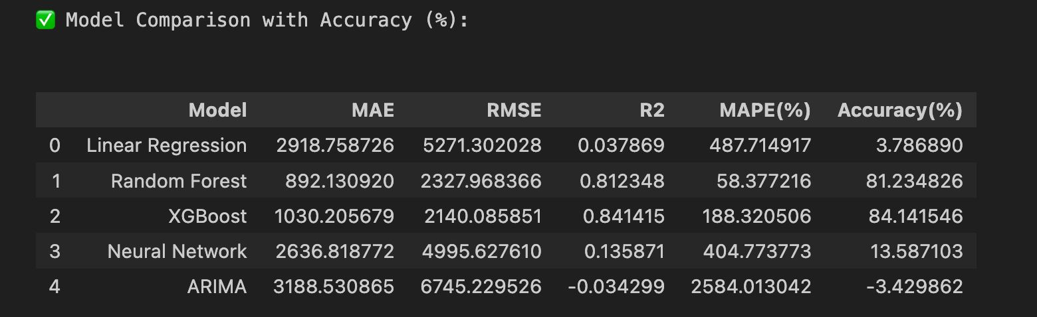
Model Accuracy

Slide 9
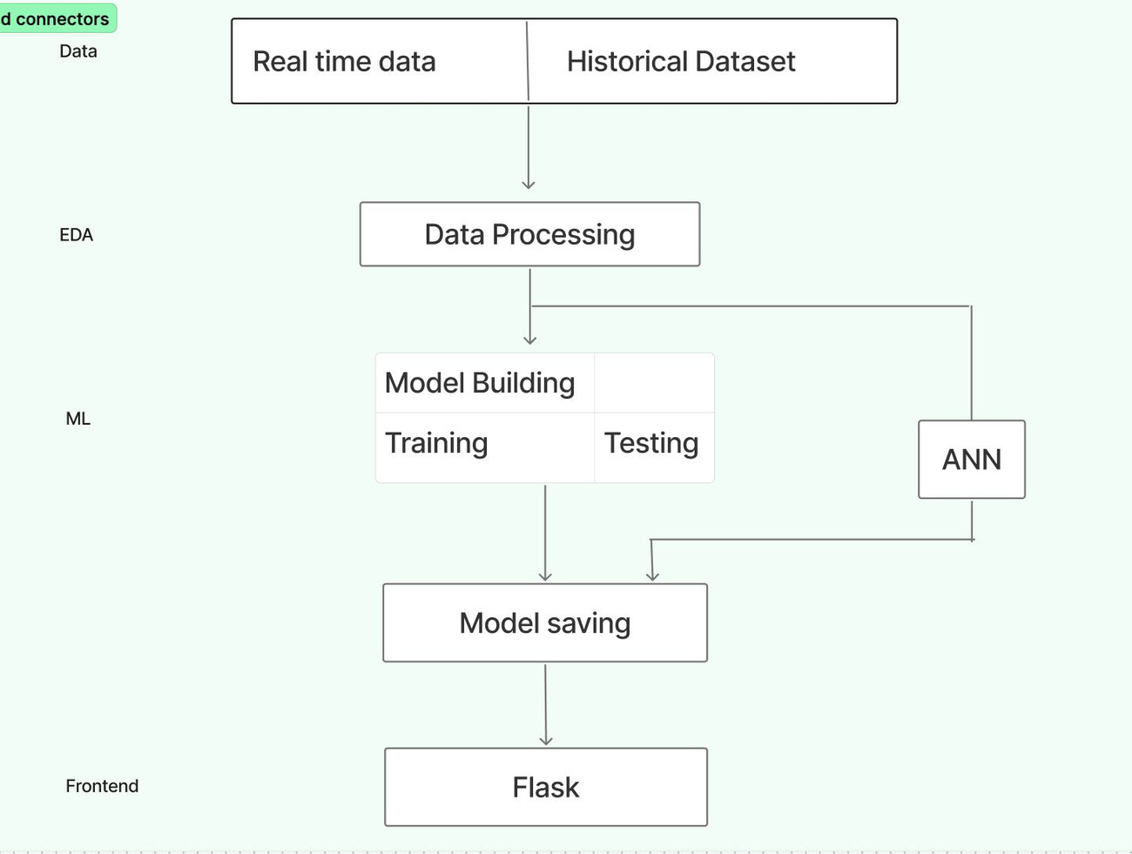
Architecture Design

Slide 10
Github Link
GitHub Link:
https://github.com/chetan82772/AI-ML-based-models-for-predicting-prices-of-agri--horticultural-commodities

Slide 11
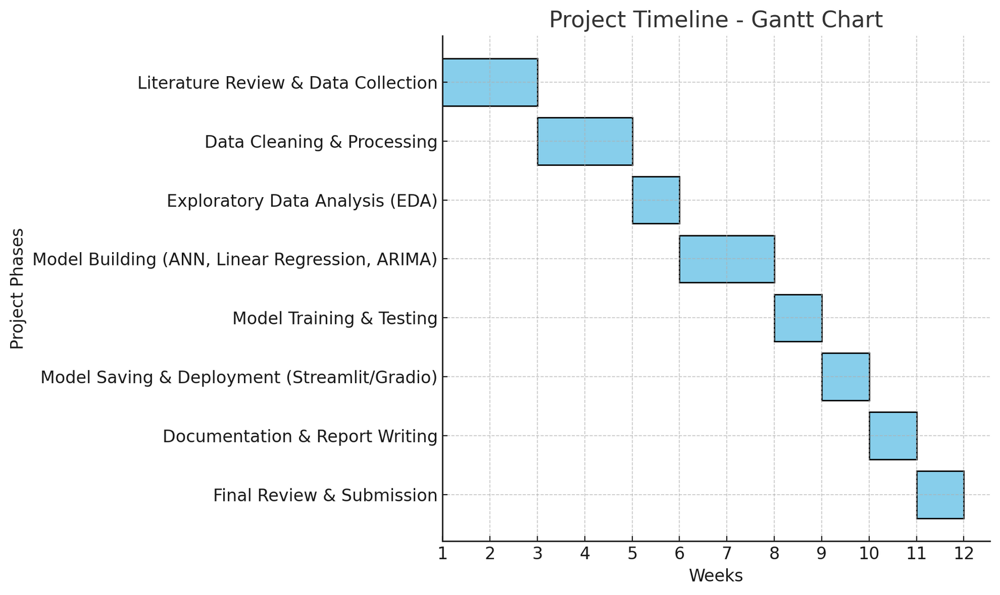
Timeline of the Project (Gantt Chart)

Slide 12
References
Mahmud, I., Das, P. R., Rahman, M. H., Hasan, A. R., Shahin, K. I., & Farid, D. M. (2024). “Predicting Crop Prices using Machine Learning Algorithms for Sustainable Agriculture.” — Proceedings of IEEE Region 10 Symposium (TENSYMP) 2024.
Karmila, Machmud R., and Evi H. T. “Agricultural Strategic Commodity Price Forecasting Using Artificial Neural Network.” Proceedings of the 2019 International Conference on Information and Communications Technology (ICOIACT), IEEE, 2019, pp. 543–548. doi:10.1109/ICOIACT46704.2019.8938476.
RNN and GNN based prediction of agricultural prices with ... — 2023 IEEE 19th International Conference on Automation Science and Engineering (CASE) (or similarly named IEEE automation conference entry).

Slide 13
References
4.Chaturvedi, Anika, Vikram Singh, and Priya Mehta. "A Multimodal Transformer Network for Spatio-Temporal Forecasting of Agri-Horticultural Commodity Yield and Price." 2025 IEEE International Conference on Agroinformatics (ICAI), 2025, pp. 1-9.
5.A Comparative study of Data Mining Techniques for Agriculture Crop Price Prediction — 2022 IEEE 7th International Conference for Convergence in Technology (I2CT 2022).
6.Zhang, D. B., Chen, S. Y., Ling, L. W., & Xia, Q. (2020). “Forecasting agricultural commodity prices using model selection framework with time series features and forecast horizons.” — IEEE Access (2020).

Slide 14
References
7.Long Short-Term Memory Model Based Agriculture Commodity Price Forecasting — 2017 IEEE International Conference on Big Data (BigData 2017) (paper in IEEE Big Data proceedings).
8.Xiong, T., Li, C., Bao, Y., Hu, Z., & Zhang, L. (2018). “Seasonal forecasting of agricultural commodity price using a hybrid STL and ELM method: evidence from the vegetable market in China.” — Neurocomputing (2018).
9.“Meta-Learning Based Adaptive Crop Price Prediction for Agriculture Application.”
Conference: 2021 IEEE 5th International Conference on Electronics, Communication and
Aerospace Technology (ICECA 2021).
10. Commodity Price Dynamics Paper (also 2016, repeated here for completeness)
The same sparse VAR commodity dynamics paper (Barbaglia et al., 2016) also includes
references and context relevant to 2018 developments.

Slide 15


